Slide 1
Walmart Sales Analysis
Manthan Varma - 712352045
Saurabh Madake - 712352023
Shivani Tiwari - 712352039

Slide 2
Table of Contents
01
Problem Statement
02
Introduction
03
Methodology
04
Result and observation
05
Conclusion
06
Reference
Description on the section
Description on the section
Description on the section
Description on the section
Description on the section
Description on the section

Slide 3
Problem Statement
"Enhance Walmart's sales efficiency by deciphering top-performing branches, popular products, and consumer trends through data analysis, aiming for strategic optimizations and improved sales methodologies."

Slide 4
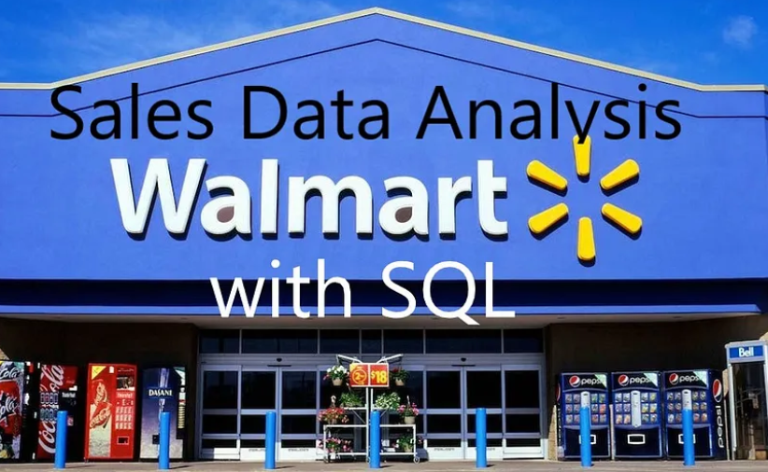
Introduction
The main purpose of this project is to take a close look at Walmart's sales information. We want to understand which branches and products are doing the best, and we also want to know how people's buying habits change over time. Our big goal is to figure out how to improve the way Walmart sells things, making the methods smarter and more effective.

Slide 5
Methodology
In the initial step of data wrangling, we inspect the data to identify and handle any missing or NULL values using appropriate replacement methods.
Build a database : create database if not exists SalesDataWalmart;
Create table and insert the data
Select columns with null values in them. There are no null values in our database as in creating the tables, we set **NOT NULL** for each field, hence null values are filtered out.
Using numpy, pandas and matplotlib we have extracted some insightful result.

Slide 6
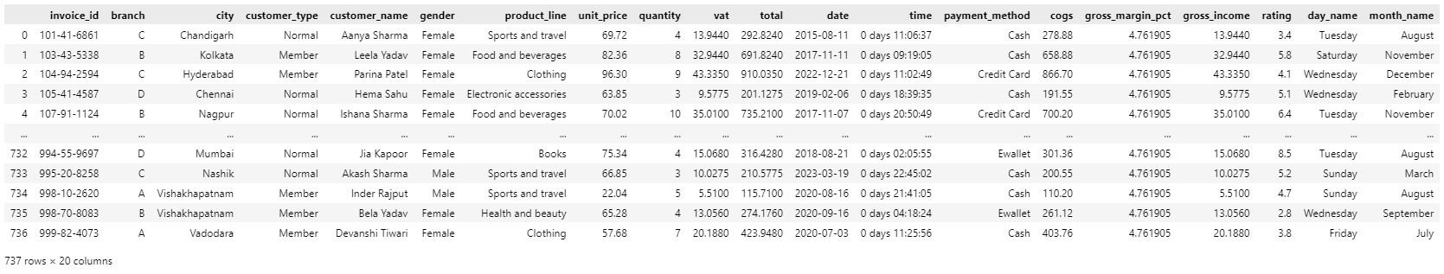
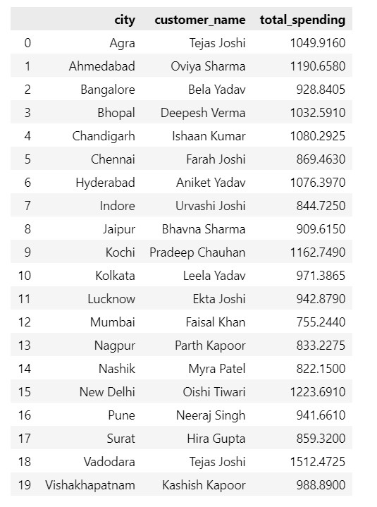
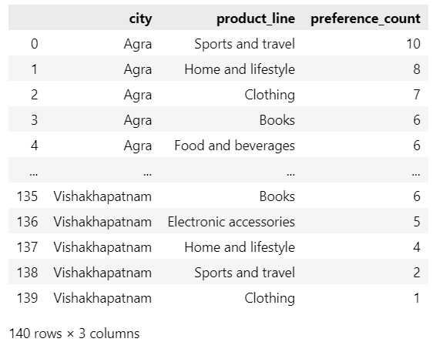
Result and Observation

Slide 7
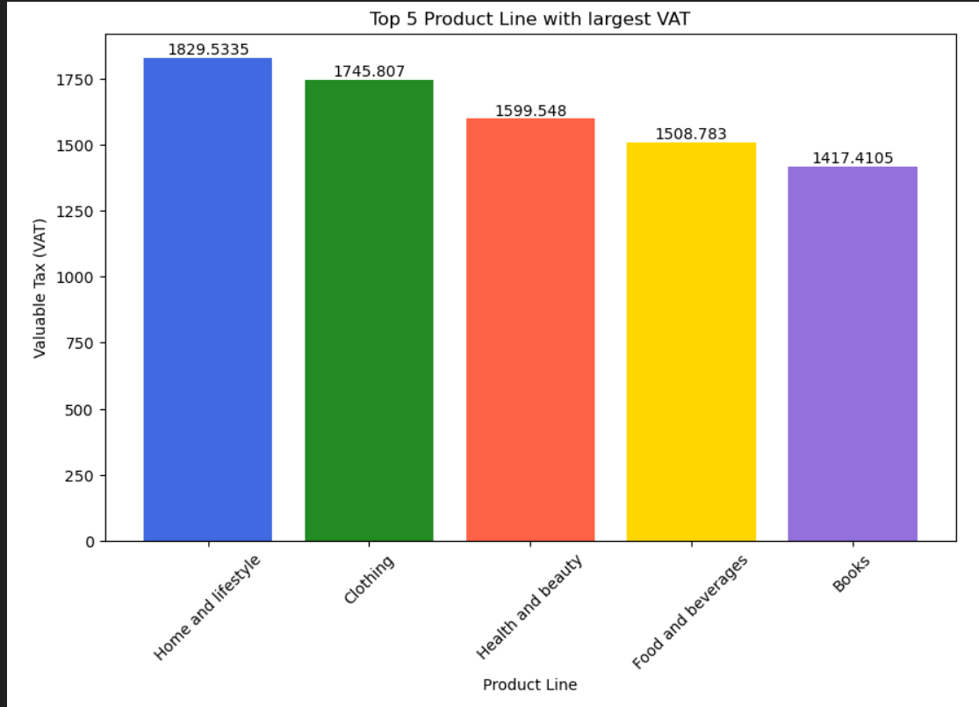
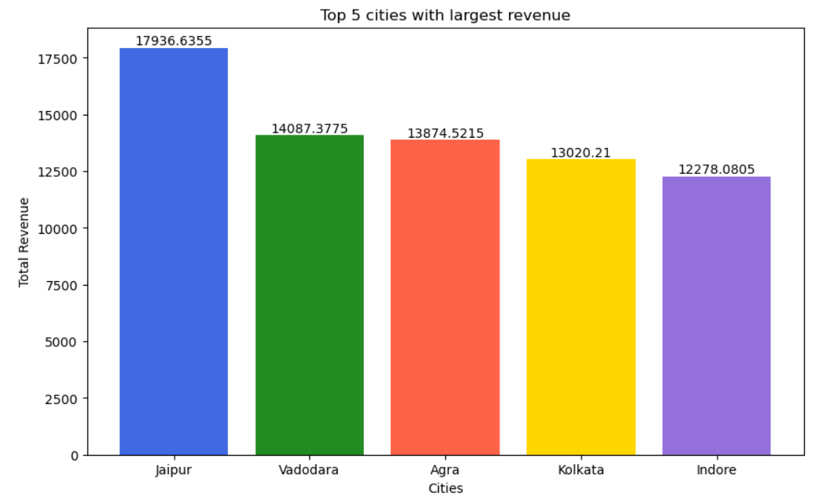
Result and Observation

Slide 8
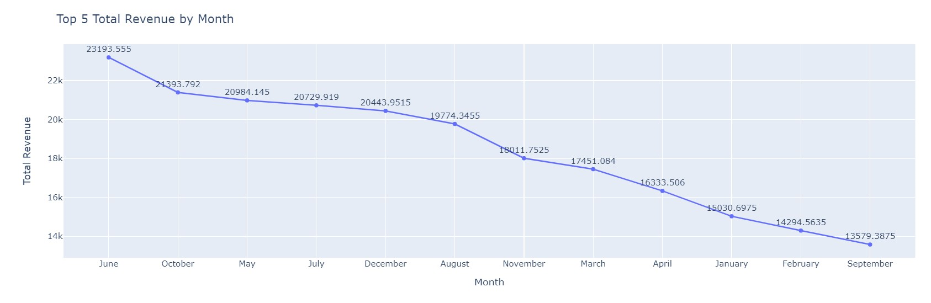
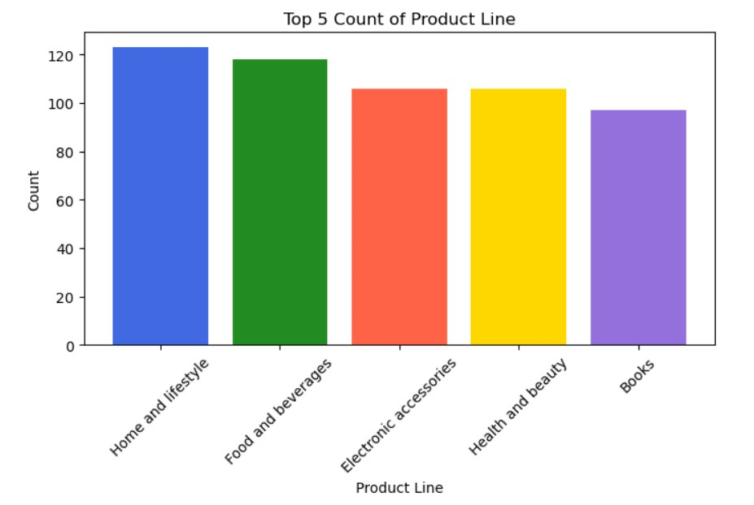

Slide 9
Conclusion
Cleaned and explored Walmart's sales data.
Addressed questions about product performance, sales trends, and customer behavior.
Identified top-performing products and branches.
Analyzed sales trends to inform strategy.
Profiled customer segments for profitability insights.
Utilized SQL queries and computed key metrics (COGS, VAT, total revenue, gross profit).
Data-driven decisions aim to enhance sales strategies, inventory management, and overall business performance.
This project serves as a foundation for ongoing analysis and future enhancements in sales forecasting and operations optimization.

Slide 10
References
https://medium.com/@zainab.mehmood/walmart-sales-analysis-sql-project-6266c2192df7
https://github.com/vibhavarik23/Python_SQL

